Slide 1
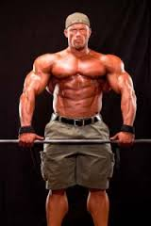
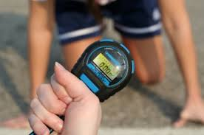
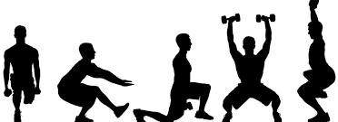
principles of Training

Slide 2
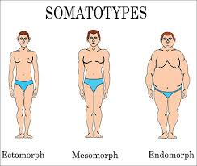
Factors Influencing Training Potential
Somatotype
Gender
Men are potentially stronger than women
Women are potentially more flexible than men
Current fitness level
Lifestyle
Diet
Smoking
Occupation
Current activity levels
Pregnancy
General health
Age

Slide 3
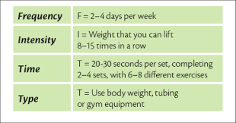
principles of training
FITT
Frequency
How often-increases as fitness progresses
Intensity
How hard-increased by
Increasing or decreasing speed, depending upon exercise
Adding impact
Larger movements, higher arms
Use of longer levers
Working against gravity
Increasing resistance
Time
How long
Type
The exercise you do

Slide 4
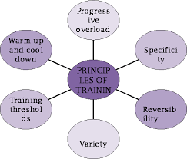
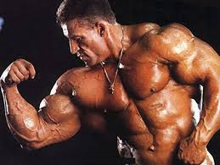
principles of training
Specificity
Adaptation
Overload
Reversibility
Progression
Overtraining
Periodization

Slide 5
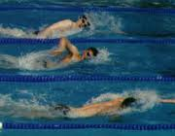
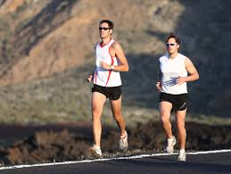
principles of training
Specificity
Identifying specific goals for the conditioning program
Closer the training is to desired outcome, the better the outcome will be
Ex: runners run, cyclists cycle, swimmers swim, etc.

Slide 6
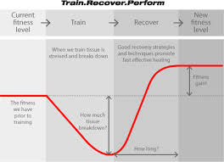
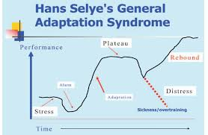
principles of training
Adaptation
Body adapts to regular training with:
Improved heart function and circulation,
Improved respiratory function,
Improved muscular strength and endurance
Improved flexibility

Slide 7
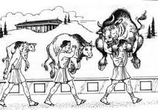
principles of training
Overload
Perform at a level above normal by increasing:
Frequency
Duration
Intensity
Not overloading may be a reason for not seeing results even though exercising regularly
SAID Principal
Specific
Adaptations to
Imposed
Demands

Slide 8
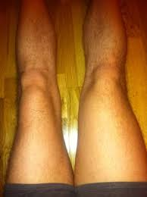
principles of training
Reversibility
Fitness decreases if training stops
Strength gains are generally lost more quickly than flexibility gains
These reverse changes may begin in as little as 48 hours—up to two weeks depending on training level

Slide 9
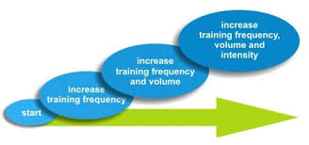
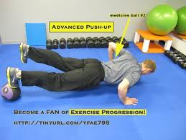
principles of training
Progression
Necessary for fitness gains
As the muscles become stronger/more efficient, they need more resistance/duration
Apply the principles of FITT
Frequency
Intensity
Time
Type

Slide 10
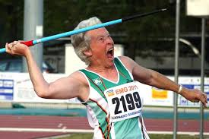
principles of training
Lever Length and Gravity
Gravity
Can provide built in resistance
Lever length
Long levers
Arms and legs fully extended
Fulcrum is the shoulders or hips
Combine short and long levers for safer workout

Slide 11
Principles of Training
OVERTRAINING SYNDROME
Occurs typically in competitive or obsessive athletes
An overload of the body’s physiological capabilities without a proper recovery time
Various signs & symptoms—subjective!
Decline in physical performance despite continued training
Change in appetite
Weight loss
Sleep disturbances
Repeated colds or sore throats
Irritability, restlessness, excitability &/or anxiousness
Loss of motivation
Lack of mental concentration & focus
Lack of enjoyment
*Associated with depression!

Slide 12
EXERCISE PROGRAMS MUST BE DESIGNED TO INCLUDE BOTH REST AND DAYS OF VARIED LEVEL OF TRAINING INTENSITY!

Slide 13
Principles of Training
Periodization
Used to prevent/alleviate issues associated with overtraining
Alternate easy, moderate, & hard periods of training
For example: Two days of hard intensity should be followed by two days of easy intensity or rest.
A week or two of hard training should be followed up with a week or two of easy training
A new training program should begin with at least 5 to 10 easy training sessions before making a progression!

Slide 14
